Slide 1

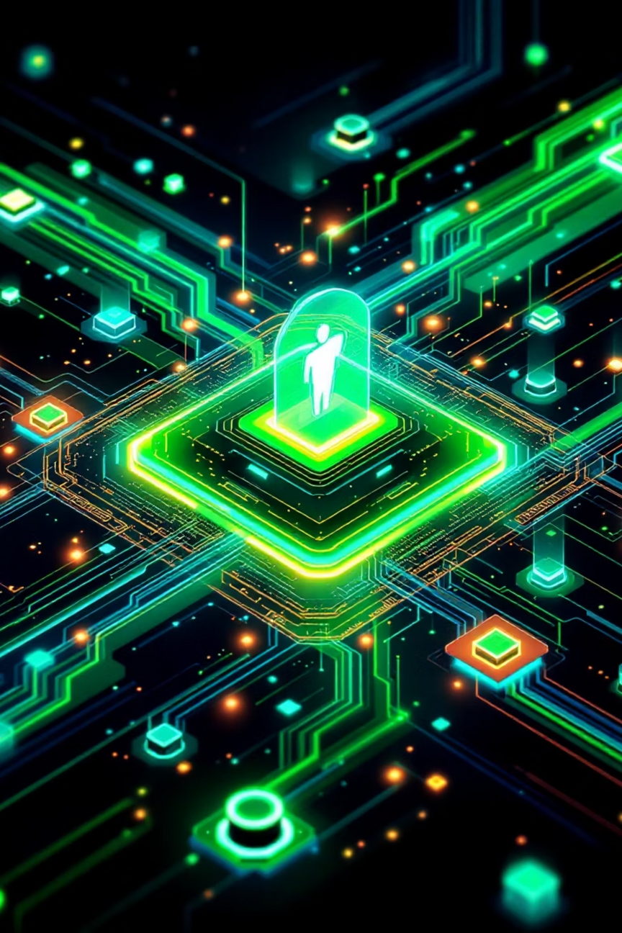
HealthSync AI
Your Personal Health Data Agent
Tackling the fragmented health-data crisis with one conversational, AI-powered profile that follows you everywhere.

Slide 2


The Problem: Data Silos Kill Care
Records trapped in silos
Hospitals, labs, wearables, and apps refuse to talk to each other.
Patients fly blind
No single source of truth means repeated tests, medication errors, and missed diagnoses.

Slide 3

The 68 % Error Epidemic
68 % of medical errors
stem from incomplete or mis-communicated information. Clinicians and patients both need a unified, real-time view of every test, pill, and trend.

Slide 4
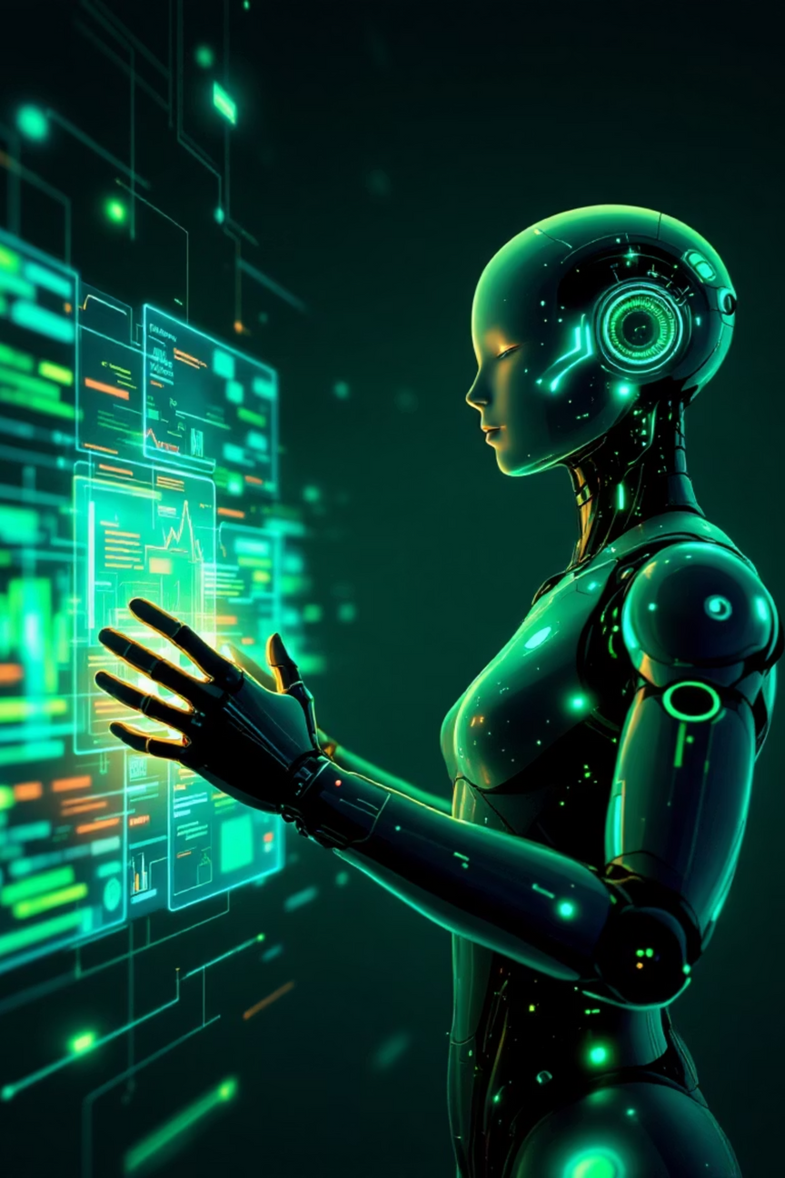
Meet HealthSync AI
AI Assistant
Unified Profile
Conversational interface for patients
One ledger from every source
Doctor Summary
Instant, evidence-ready reports

Slide 5




Key Features That Save Lives
Data Fusion
Conflict Alerts
API, OCR, wearables, EHR—auto-ingested & de-duplicated.
AI flags dangerous drug or test overlaps before they happen.
Emergency QR
Secure Share
Critical info accessible even when the patient can’t speak.
One-click, HIPAA-compliant collaboration with any provider.

Slide 6

How the Magic Happens
01
Collect
Pull data via FHIR, HealthKit, Google Fit, OCR, Bluetooth.
02
Reconcile
De-duplicate, normalize, and time-stamp every record.
03
Analyse
LLMs surface trends, risk scores, and next-best actions.
04
Converse
Patients chat; doctors get auto-summaries & citations.

Slide 7

Built for Scale & Security
Stack
Trust
Backend: Python micro-services, Node.js
OAuth 2.0 + FHIR R4
End-to-end AES-256 encryption
AI/NLP: GPT-4, Hugging Face, spaCy
HIPAA, GDPR, SOC-2 compliant
DB: MongoDB + PostgreSQL hybrid
Zero-trust architecture
Mobile: React Native / Flutter

Slide 8
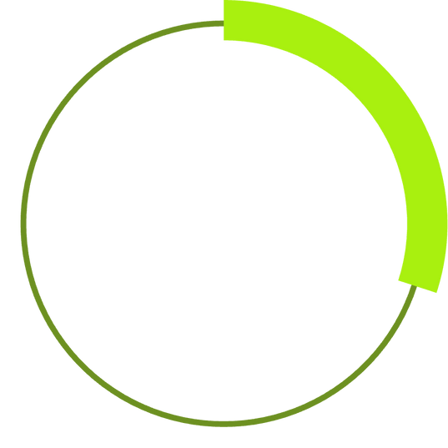
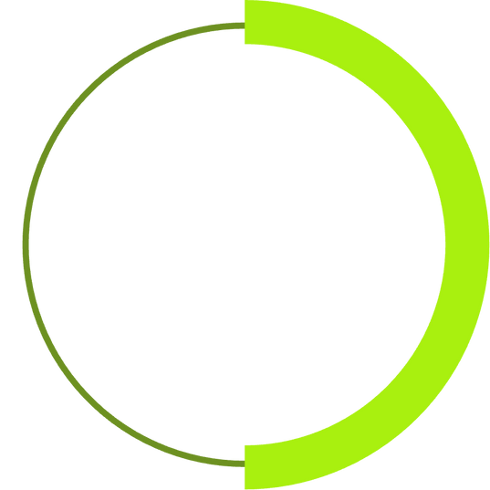

Wins for Every Stakeholder
30 %
50 %
90 %
Cost Drop
Faster Dx
Patient Sat
Fewer duplicate tests & admissions
Doctors see full history instantly
Feel heard, safe, and in control

Slide 9

Roadmap to Market
Phase 1 MVP
Phase 3
Data aggregation + chatbot pilot with 2 hospital chains
Doctor collaboration suite, advanced analytics, payer integrations
1
2
3
Phase 2
AI insights, predictive alerts, OCR for handwritten notes

Slide 10
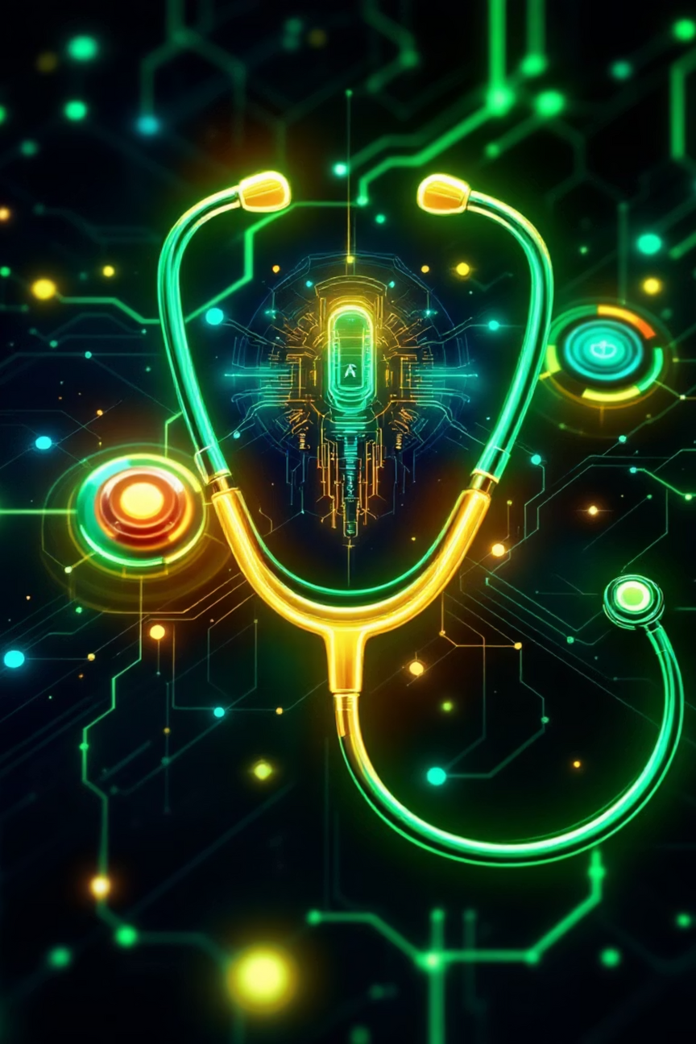


Invest in the “Google Assistant for Healthcare”
Our Vision
Every Indian carries a personal, AI guardian that makes healthcare smarter, safer, and truly patient-first. Join us to turn fragmented data into collective wellness.

Slide 11
THANK YOU
Presented by:-
(1) sai subham swar
(2) Lopamudra Mahapatra
(3) pragnya priyadarshini
(4) suraj Kumar Jena

